Slide 1
Unlike The Others
Here Where everything Change

Slide 2
OUR TEAM MEMBERS

Slide 3
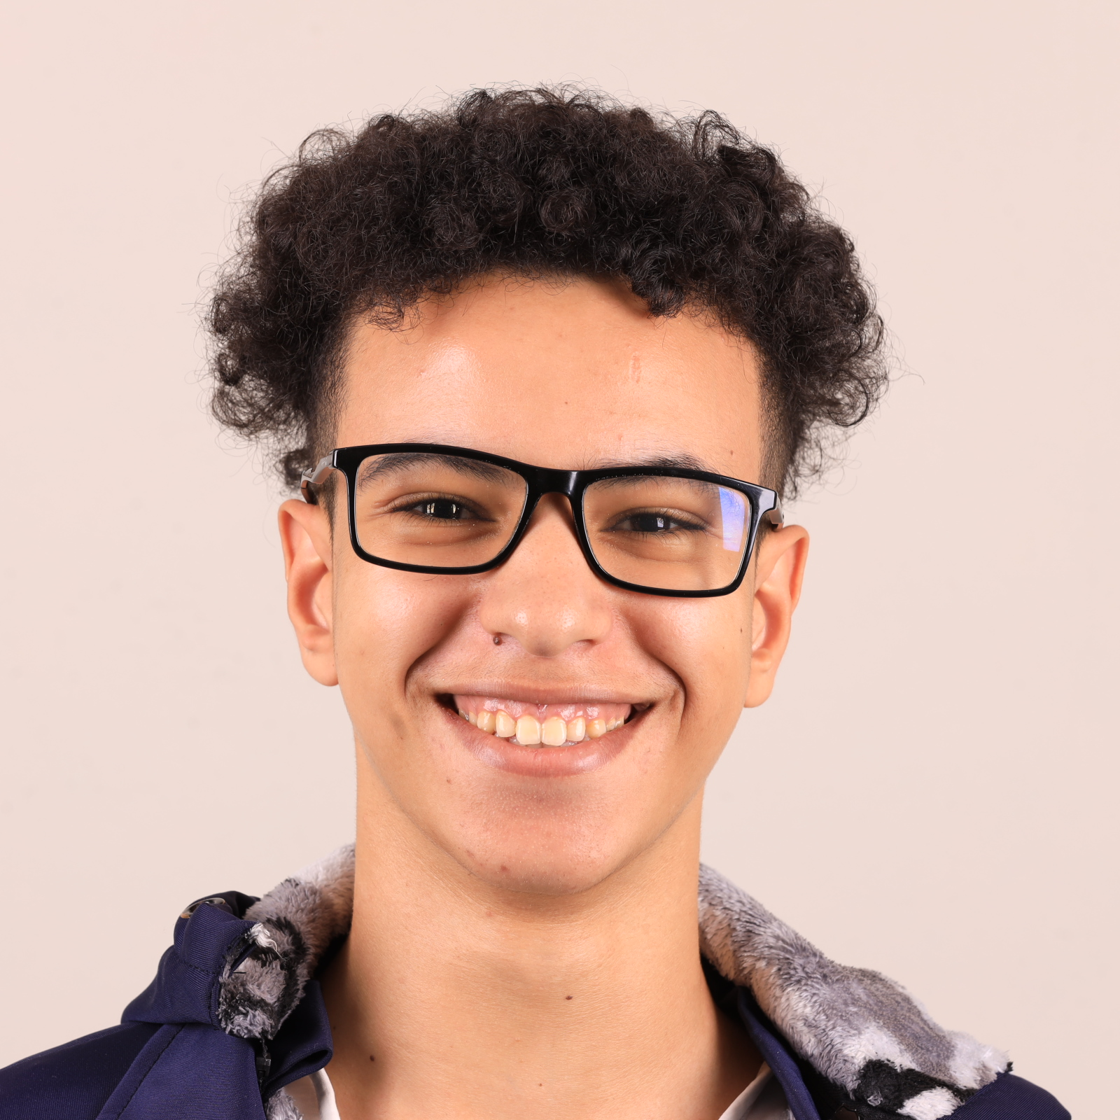
President
Youssef Elhoubi
Full stack developer specialize in MERN stack
President of BDE
Decision maker
Promises :
Act as the primary voice for students, representing their needs and concerns.
Plan activities, events, and workshops that enrich student life.

Slide 4
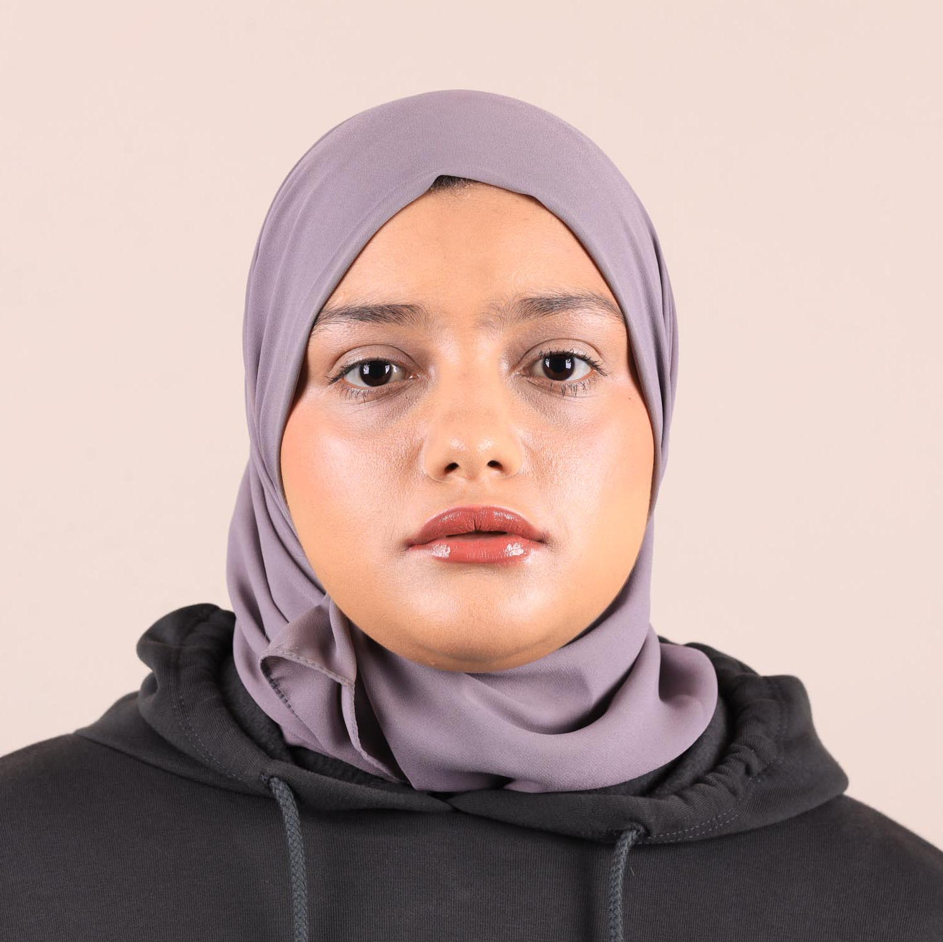
Vice-President
Tawba Zehaf
Full stack developer
Vice-President of BDE
Help President to make better decisions
Promises :
Ensure students’ opinions are heard and their suggestions are considered.
Encourage collaboration and networking among students and with industry professionals.

Slide 5
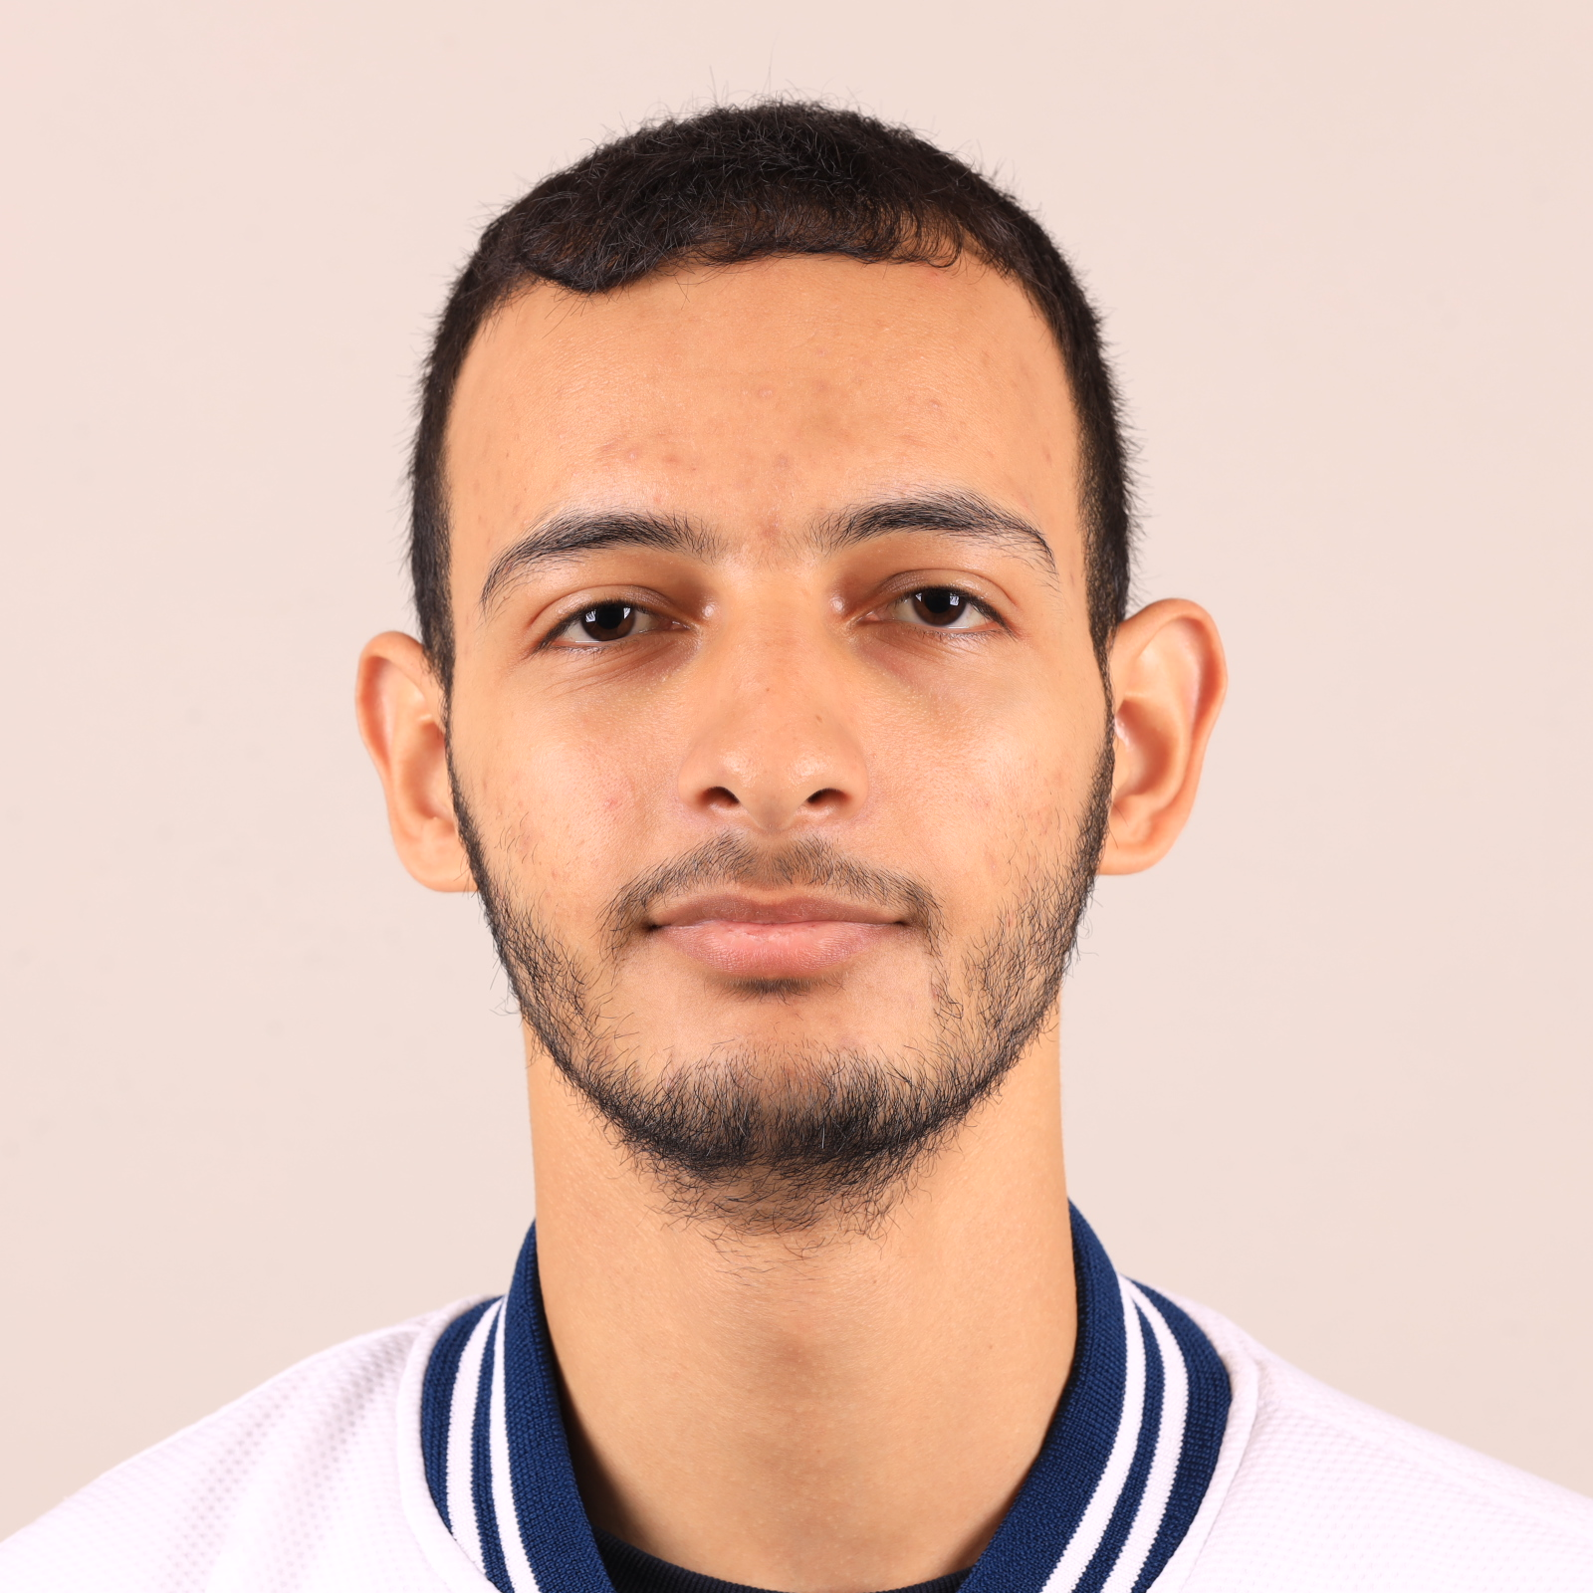
Advisor
Abderrahmmane Rabeh
Full stack developer MERN / LARAVEL
Advisor of BDE
Promises :
Share knowledge and experience to help them navigate challenges and make informed decisions.
Mediate any conflicts within the BDE team or between the BDE and students.

Slide 6
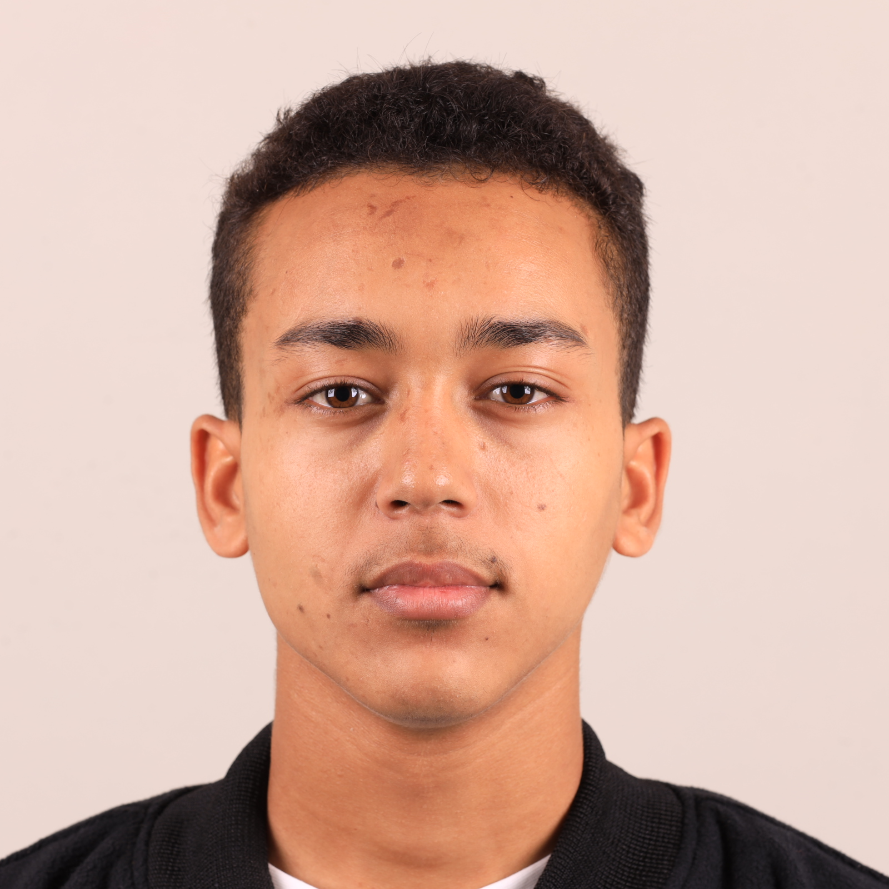
Advisor
Taha Mlaiki
Full stack developer
Advisor of BDE
Promises :
Guide the BDE to approach issues with diplomacy, fairness, and open-mindedness.
Ensure that events align with the mission of the BDE and bring real value to students.

Slide 7
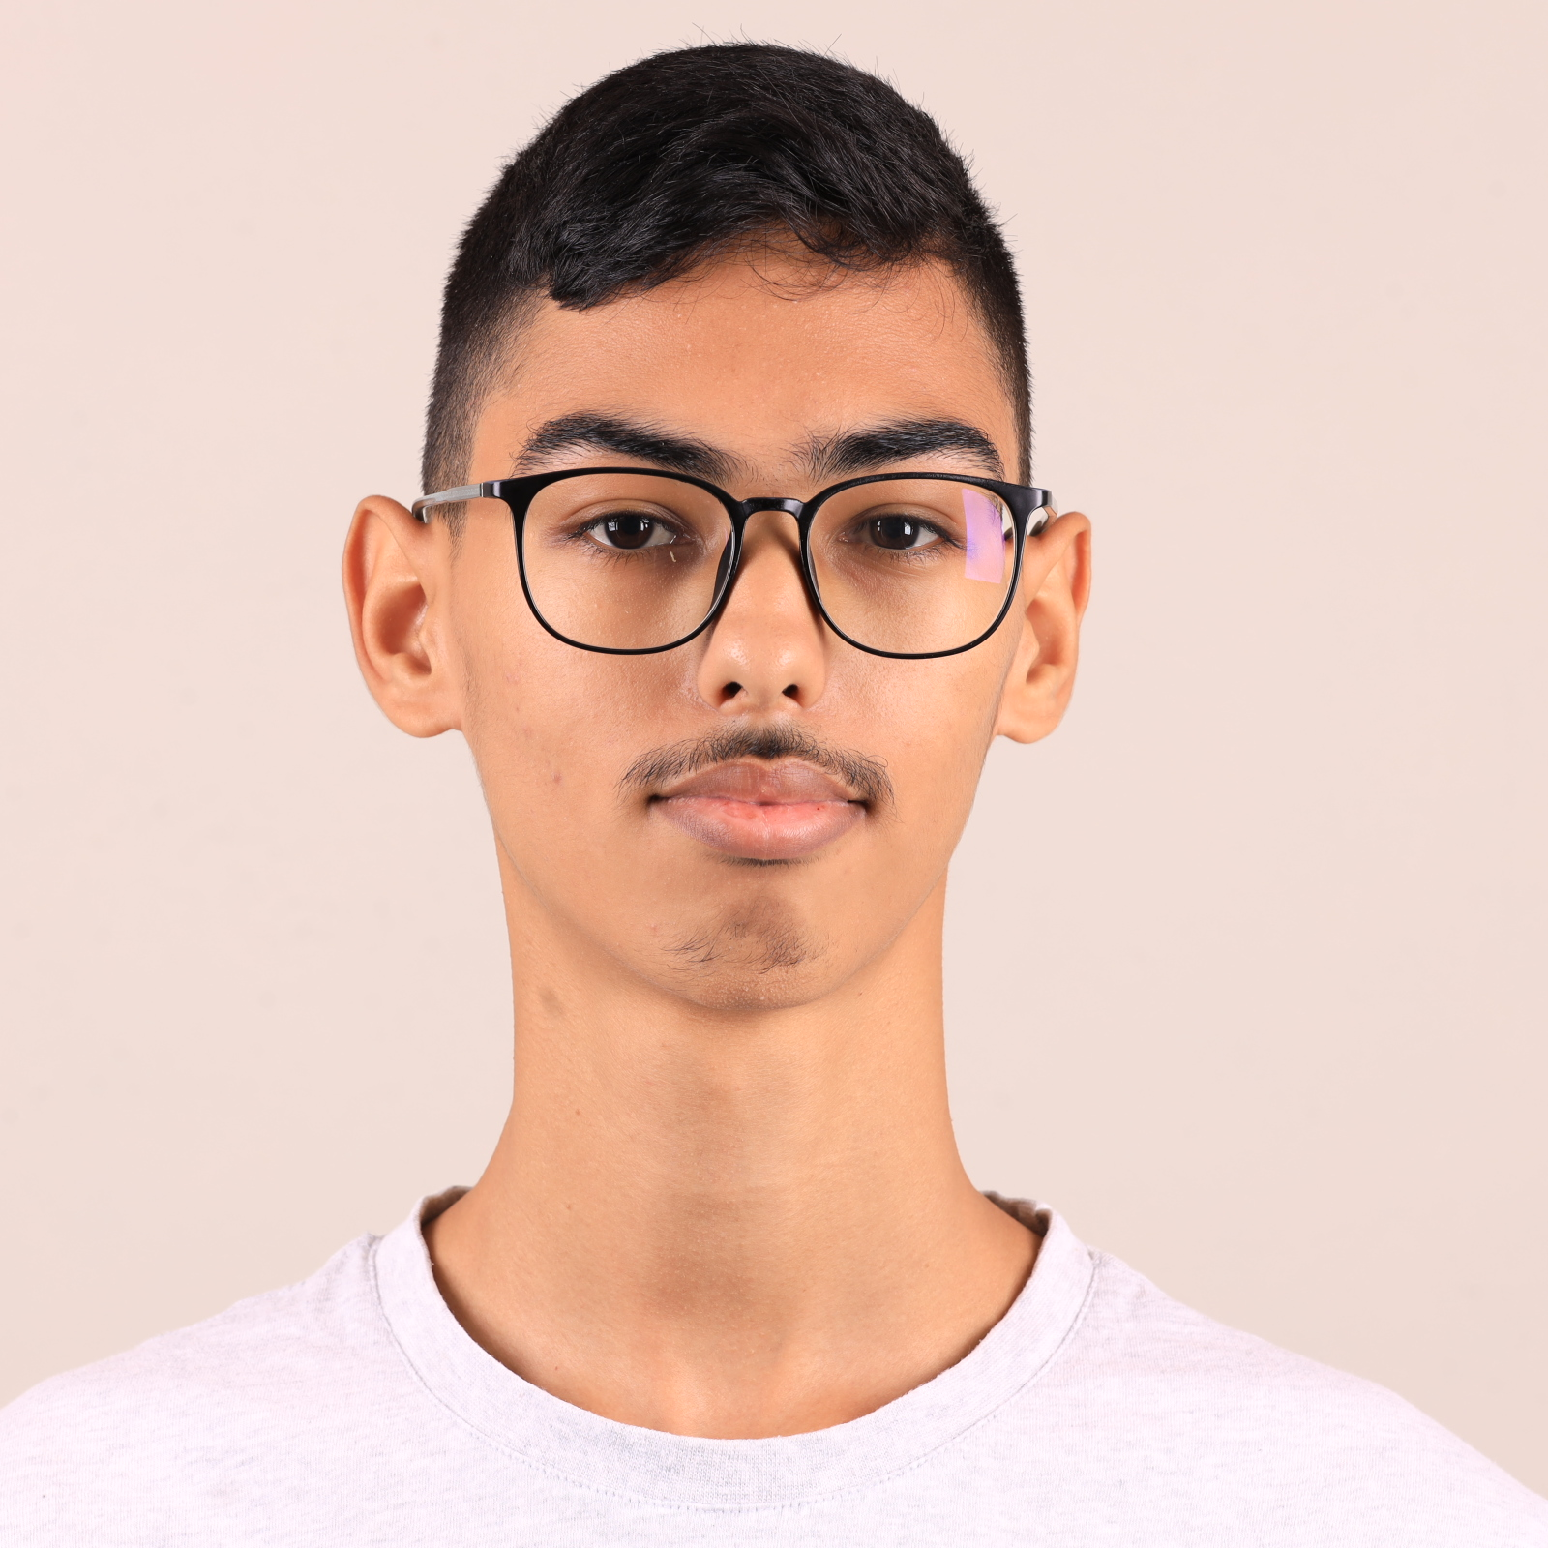
Treasurer
Ilyass Anida
Full stack developer
Treasurer of BDE
Promises :
Support clubs financially so they can achieve their mission, whether it’s organizing events, hosting workshops, or creating student resources
Manage relationships with sponsors, ensuring that partnerships align with the BDE’s values and mission

Slide 8
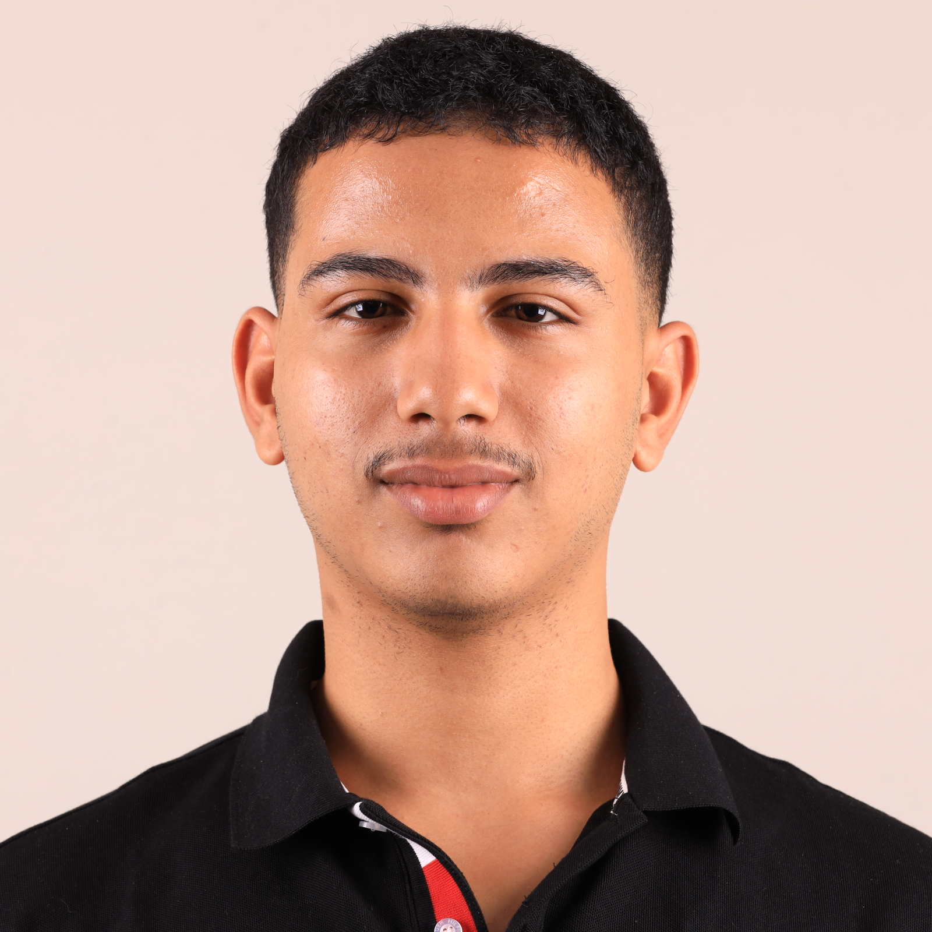
Responsible for External Relations
Yasser Aboufaris
Junior front end developer
Responsible for External Relations of BDE
Promises :
Identify and establish partnerships with companies, organizations, and professionals that align with the BDE’s goals and the interests of students
Seek opportunities for sponsorships, internships, and job placements for students, bringing value to the student community

Slide 9
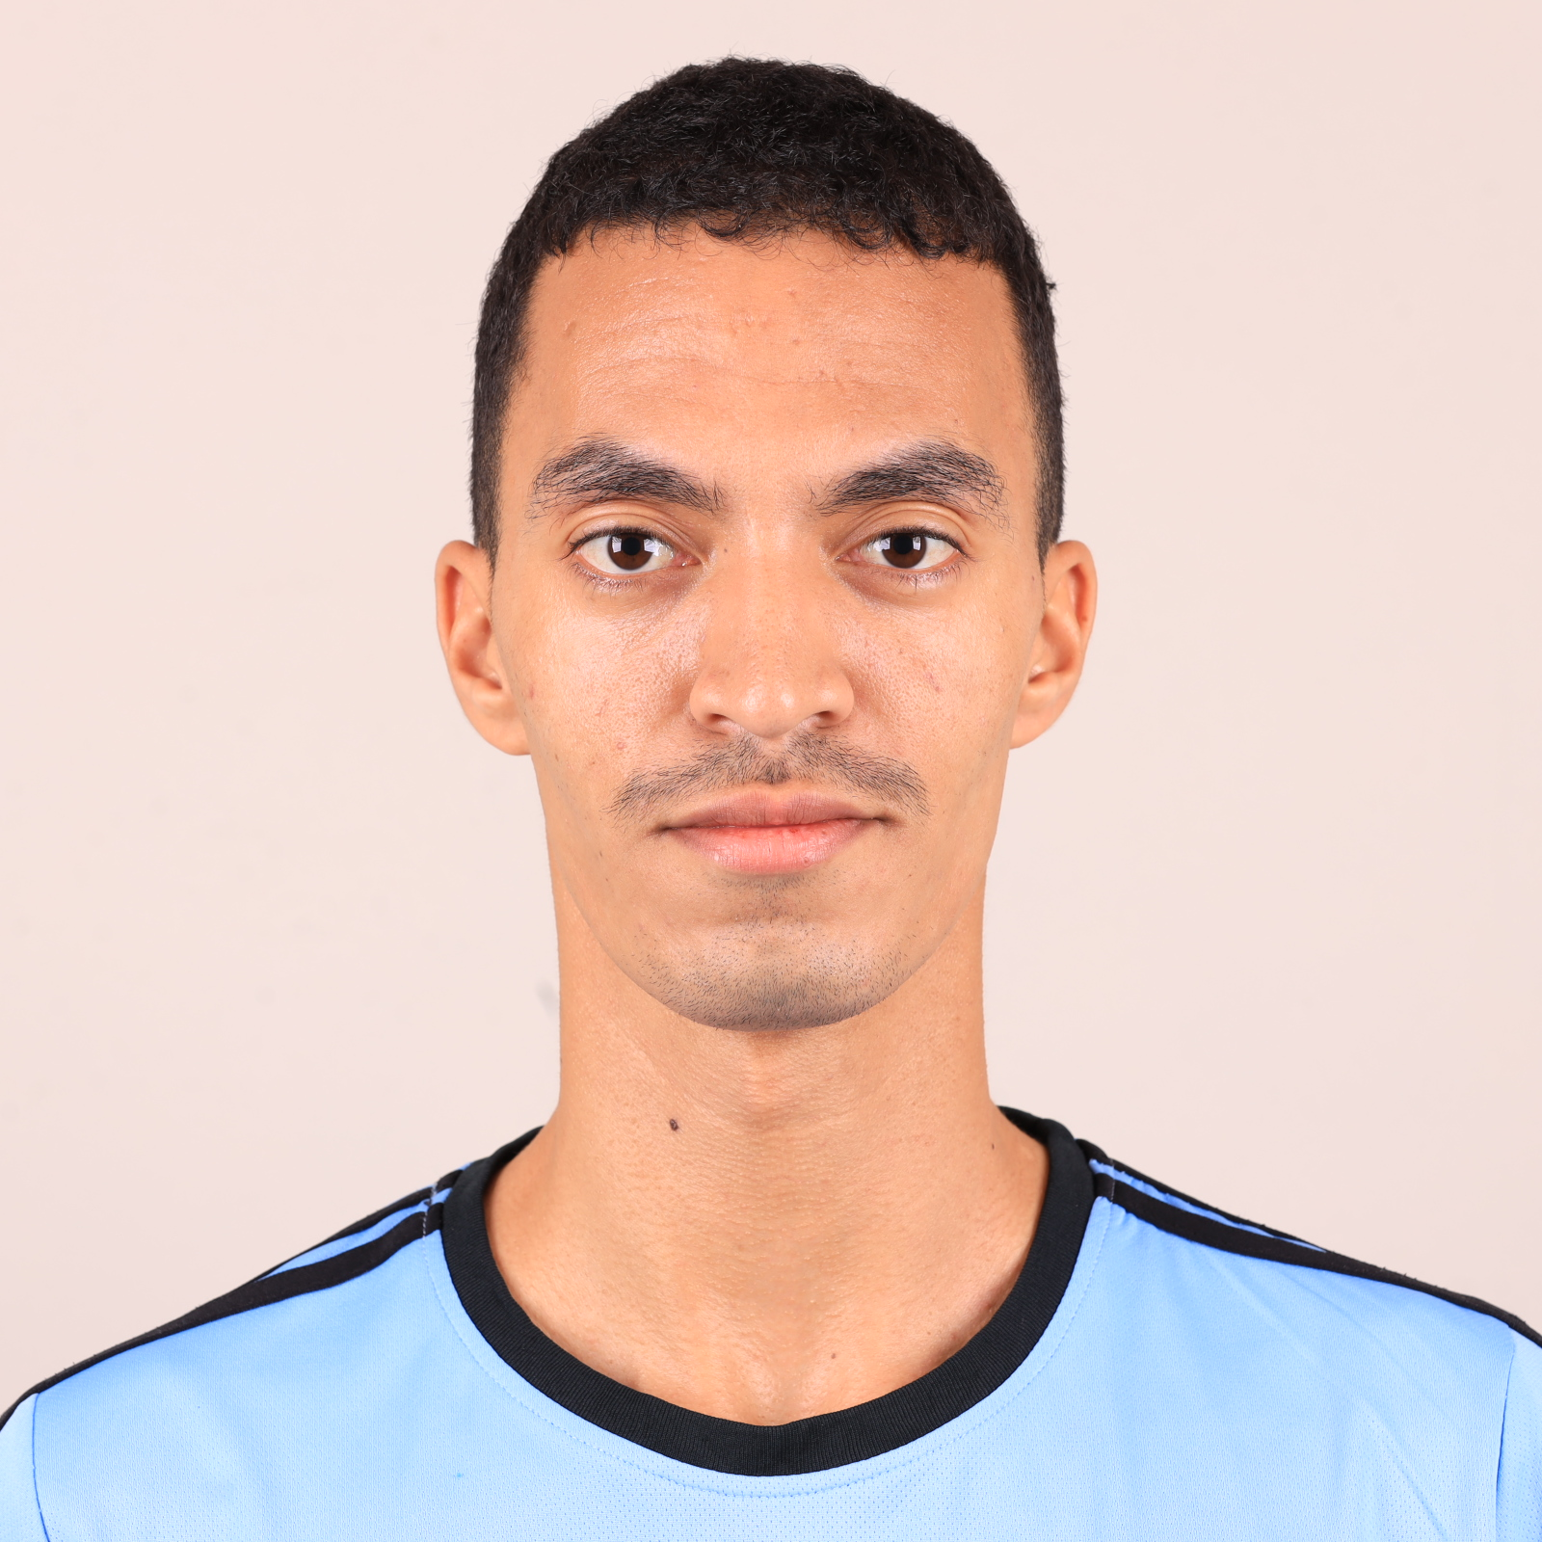
Responsible for External Relations
Abdelmalek Labid
Junior front end developer
Responsible for External Relations of BDE
Promises :
Manage all formal communications between the BDE and external parties, including emails, presentations, and proposals
Stay updated on industry trends and identify potential opportunities that would benefit students or enhance the BDE’s offerings.

Slide 10
Join Us in Building a Better Tomorrow
As we look to the future, our vision is clear: to create an enriching and supportive environment where each of you can thrive. Through collaboration, partnership, and dedication, we’re here to help you reach your goals and make the most of your time at YouCode
We promise to work tirelessly to connect you with internships, especially with leading companies in tech, so you can gain hands-on experience and start building your careers even before you graduate. Through our partnerships, we’ll open doors to placements, mentorships, and industry exposure

Slide 11
Vote for a Better YouCode Experience
Vote for Us – Together
We’ll Make a Difference !
By choosing us as your BDE, you’re choosing a future filled with growth, support, and endless possibilities. Let’s create a memorable and impactful year at YouCode!

Slide 12
Vote for Unlike The Others
and be part of something extraordinary!

